Slide 1

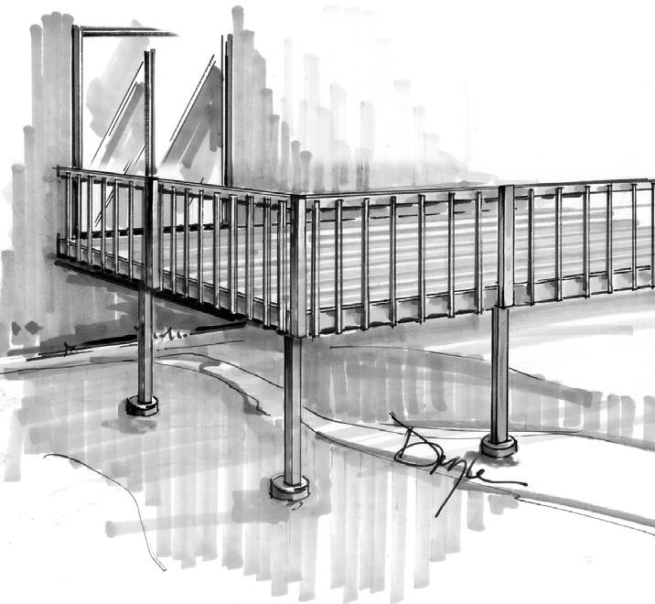
Building Guide
03/20/26
Colorado Chapter of the International Code Council
Single Family Residential Uncovered Decks and Porches
How to Use this Guide
Check with your AHJ (authority having jurisdiction) regarding type of submittal (paper or electronic) and for additional requirements. Draw to scale and complete the following (hint: use graph paper with ¼” squares. Example: ¼” = 1’).
Complete this Building Guide by filling in the blanks on page 3 and indicating which construction details will be used.
Provide Plot Plan (site plan) showing dimensions of your project or addition and its relationship to existing buildings or structures on the property and the distance to existing property lines drawn to scale. See page 2.
Fill out a building permit application..
The majority of permit applications are processed with little delay. The submitted documents will help determine if the project is in compliance with building safety codes, zoning ordinances and other applicable laws.
The Colorado Chapter of the International Code Council is a professional organization seeking to promote the public health, safety and welfare to building construction. We appreciate your feedback and suggestions. please write to the Colorado chapter of the International code Council, P.O. Box 961, Arvada, CO 80001.This building guide can be found on Colorado Chapter of the International Code Council website at: http:// www.coloradochaptericc.org
This handout was developed by the Colorado Chapter of the International Code Council as a basic plan submittal under the 2024 International Residential Code. It is not intended to cover all circumstances. Check with your Department of Building Safety for additional requirements.
1

Slide 2






Single Family Residential Uncovered Decks and Porches
03/20/26
Note: A plot plan (plan view) showing the dimensions of your project or additions and its relationships to existing buildings or structures on the property must be included. In addition to project dimensions, your plot plan must also show other details such as post locations and spacing, joist and beam spans, and any other pertinent information not shown on the section drawing.
Site Pl a n E x a m p l e
131.0
9. 5
Proposed Addition
One Story Fram e
75.0
Hometown Street
1”=20’
Note: Dimensions are for reference purposes only
40. 0
40.0
75.0
5’ Utility Easment
Walkway
30.0
26.0
Concrete Slab for Garage
24.2
45.8
20. 0
20. 0
Concrete Drive
59.2
25. 5
5.5
131.0
Plan Vi ew Example
Tempered windows may be required
Decking
Light
Door to interior
Electrical outlet
Tempered windows may be required Decking Light Door to interior Electrical outlet
36” Min.
Stairs
Joists
1/4” = 1
nstall dia onal br Beams
x = Show Dimension
36” Min.
Stairs
Maintain 30”W X 36”D working space at existing electrical service panel.
x
Joists
x
Show post and
pier size
1/4” = 1
Beams
x
x
x
x
x = Show Dimension
Lateral bracing is required per Section R507.9.2
This handout was developed by the Colorado Chapter of the International Code Council as a basic plan submittal under the 2024 International Residential Code. It is not intended to cover all circumstances. Check with your Department of Building Safety for additional requirements.
2

Slide 3


Single Family Residential Uncovered Decks and Porches
03/20/26
Directions:
1. Fill in the blanks. Please print legibly.
2. Indicate in the check box which detail from page 6
will be used.
Address:
Size and Spacing of Lag Bolts
(example: Two rows1/2”x 4 1/2” lags @ 16” O.C.)
See Table 1
Deck Section
Type of decking
x -
(example: 1 x 4 or 2 x 6 orTrex)
Existing bldg.
Electrical outlet required on decks
36” high guard with balusters spaced so that a 4 Inch diameter sphere cannot pass through
2x joists spaced " apart
(example: 2 x 10" spaced 24" apart) See Table2
36 inches min.
Approved flashing required
Beam splices to occur over posts with 1 ¹/2" bearing
( ) x beam
(example: (2) 2 x 10 - see detail B) See Table3
A
Attach decking with noncorrosive fasteners
B
Wood Species:
(example: Western Cedar or Southern Yellow Pine)
✔ Check one
6 Ft. 8 in. min. (see note)
Detail B
Alternate Detail B1
Alternate Detail B2
(see page 6)
x posts spaced apart (example: 4 x 4 posts spaced 8' apart) Post height see Table4
Detail A
(see page 6)
Conditions such as attachment to cantilevers require Engineer’s approval
Span
(example: 13' - 4" )
Span
Type of exterior wall covering
(example: siding, brick, stucco) )
Detail C
(see page 6)
Finished Grade
C
Note: Emergency escape windows are allowed to be installed under decks and porches provided the location of the deck allows the emergency escape window to be fully opened and provides a path not less than 36” in height to a yard or court. 6’8” required for walk out basements or patios.
below frost depth check with your
jurisdiction
This handout was developed by the Colorado Chapter of the International Code Council as a basic plan submittal under the 2024 International Residential Code. It is not intended to cover all circumstances. Check with your Department of Building Safety for additional requirements.

Slide 4












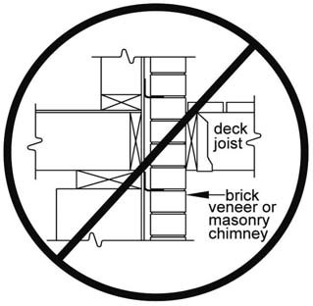
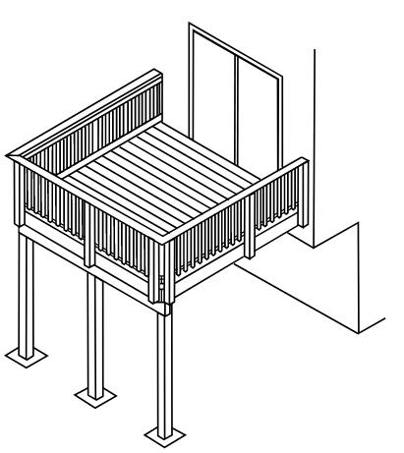
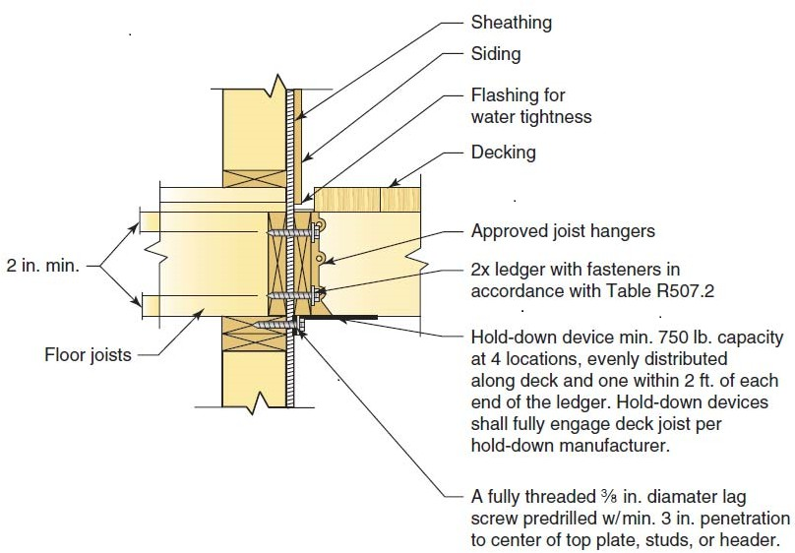
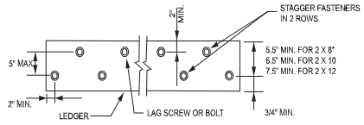

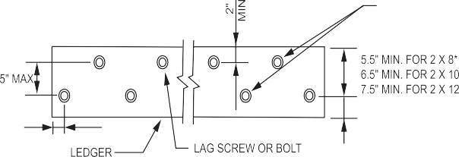
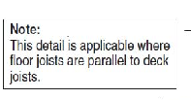
03/20/26
Single Family Residential Uncovered Decks and Porches
Table 1 Ledger connection
NOTE: Contact your local jurisdiction where snow loads exceed 40 psf.
Deck live load =40psf; Snowload =40psf; Dead load=10 psf
TABLE R507.9.1.3(1) DECK LEDGER CONNECTION TO BAND (RIM) JOIST
CONNECTION DETAILS | JOIST SPAN
 | less
 | On-center spacing of fasteners
1/2 -inch diameter lag screw with 1/2 -inch maximum sheathing | 30 | 23 | 18 | 15 | 13 | 11 | 10
1/2 -inch diameter bolt with 1/2 maximum sheathing | 36 | 36 | 34 | 29 | 24 | 21 | 19
1/2-inch diameter bolt with I-inch maximum sheathing | 36 | 36 | 29 | 24 | 21 | 18 | 16
☛
Ledger minimum size 2x8 pressure treated
HF, DF or SP #2 or better; shall not be supported by stone or masonry veneer. Attachment to a cantilevered floor requires engineering design and approval by AHJ.
Refer to 2024 IRC Section R507 EXTERIOR DECKS
for additional code language, tables, and information on exterior deck construction.
See Detail A on page 6 for additional reference
Sheathing
Siding
Flashing for water tightness
Decking
2 in. min.
Approved Joist hangers
2x ledger with fasteners in accordance with Table R507.2
Floor joists
Hold-down device min. 750 lb. capacity at 4 locations, evenly distributed along deck and one within 2 ft. of each end of the ledger. Hold-down devices shall fully engage deck joist per hold-down manufacturer.
Note:
This detail is applicable where floor joists are parallel to deck joists.
A fully threaded ¾ in. diameter lag screw predrilled w/min. 3 in. penetration to center of top plate, studs, or header.
TABLE R507.9.1.3(2) PLACEMENT OF LAG SCREWS AND BOLTS IN DECK LEDGERS AND BAND JOISTS
MINIMUM END AND EDGE DISTANCES AND SPACING BETWEEN ROWS
 | TOP EDGE | BOTTOM EDGE | ENDS | ROW SPACING
Ledger | 2 inches | 3/4 inch | 2 inches | l -5/8 inches
Band Joist | 3/4 inch | 2 inches | 2 inches | l -5/8 inches
This handout was developed by the Colorado Chapter of the International Code Council as a basic plan submittal under the 2024 International Residential Code. It is not intended to cover all circumstances. Check with your Department of Building Safety for additional requirements.

Slide 5
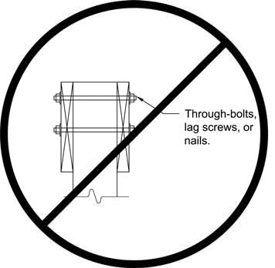

03/20/26
Singl e Fam ily R esi dent ia l Un cove red D ec ks an d Porches
TABLE R507.6DECK JOIST SPANS FOR COMMON LUMBER SPECIES
Table 2 -Wood Joist simple span
Maximum Live Load or Ground Snow Load 40psf, Maximum Dead Load 10psf
Deflection L/360 Main span; L/180 cantilever
WOOD SPECIES grade # 2 or better | JOIST SIZE | MAXIMUM JOIST SPAN |  |  | MAXIMUM CANTILEVER
 |  | SPACING OF DECK JOISTS (inches) |  |  | SPACING OF DECK JOISTS WITH CANTILEVERS (inches)
 | Simple Span | 12 on center | 16 on center | 24 on center | 12 on center | 16 on center | 24 on center
Southern pine | 2x6 | 9-11 | 9-0 | 7-7 | 1-3 | 1-4 | 1-6
 | 2x8 | 13-1 | 11-10 | 9-8 | 2-1 | 2-3 | 2-5
 | 2x10 | 16-2 | 14-0 | 11-5 | 3-4 | 3-6 | 2-10
 | 2x12 | 18-0 | 16-6 | 13-6 | 4-6 | 4-2 | 3-4
Douglas fir- larch, hem- fir, spruce-pine-fir | 2x6 | 9-6 | 8-8 | 7-2 | 1-2 | 1-3 | 1-5
 | 2x8 | 12-6 | 11-1 | 9-1 | 1-11 | 2-1 | 2-3
 | 2x10 | 15-8 | 13-7 | 11-1 | 3-1 | 3-5 | 2-9
 | 2x12 | 18-0 | 15-9 | 12-10 | 4-6 | 3-11 | 3-3
Other Wood Species are subject to review by the Authority Having Jurisdiction (AHJ)
TABLE R507.5 DECK BEAM SPAN LENGTHS
Maximum Live Load or Ground Snow Load 40psf, Maximum Dead Load 10psf
Deflection L/360 Main span; L/180 cantilever
Table 3 - Wood Beam simple span
WOOD SPECIES grade #2 or better | SIZE | DECK JOIST SPAN (ft-in)LESS THAN OR EQUAL TO:
 |  | 6 | 8 | 10 | 12 | 14 | 16 | 18
Southern pine | (2)-2x8 | 8-9 | 7-7 | 6-9 | 6-2 | 5-9 | 5-4 | 5-0
 | (2)-2x10 | 10-4 | 9-0 | 8-0 | 7-4 | 6-9 | 6-4 | 6-0
 | (2)-2x12 | 12-2 | 10-7 | 9-5 | 8-7 | 8-0 | 7-6 | 7-0
 | (3)-2x8 | 10-10 | 9-8 | 8-6 | 7-9 | 7-2 | 6-8 | 6-4
 | (3)-2x10 | 13-0 | 11-3 | 10-0 | 9-2 | 8-6 | 7-11 | 7-6
 | (3)-2x12 | 15-3 | 13-3 | 11-10 | 10-9 | 10-0 | 9-4 | 8-10
Douglas fir-larch, hem-fir, spruce-pine-fir, | 3 x 8 or (2)- 2 x 8 | 6-10 | 5-11 | 5-4 | 4-10 | 4-6 | 4-1 | 3-8
 | 3 x 10 or (2)- 2 x 10 | 8-4 | 7-5 | 6-6 | 5-11 | 5-6 | 5-1 | 4-8
 | 3 x 12 or (2)- 2 x 12 | 9-8 | 8-5 | 7-6 | 6-10 | 6-4 | 5-11 | 5-7
 | 4x6 | 6-5 | 5-6 | 4-11 | 4-6 | 4-2 | 3-11 | 3-5
 | 4x8 | 8-5 | 7-3 | 6-6 | 5-11 | 5-6 | 5-2 | 4-10
 | 4x10 | 9-11 | 8-7 | 7-8 | 7-0 | 6-6 | 6-1 | 5-8
 | 4 x12 | 11-5 | 9-11 | 8-10 | 8-1 | 7-6 | 7-0 | 6-7
 | (3)-2x8 | 9-8 | 8-6 | 7-7 | 6-11 | 6-5 | 6-0 | 5-8
 | (3)-2x10 | 12-0 | 10-5 | 9-4 | 8-6 | 7-10 | 7-4 | 6-11
 | (3)-2x12 | 13-11 | 12-1 | 10-9 | 9-10 | 9-1 | 8-6 | 8- 1
Other Wood Species are subject to review by the AHJ
Table 4 - Wood Post
☛
TABLE R507.4 DECK POST HEIGHT
Use of engineered lumber is not covered by this guide.
This handout was developed by the Colorado Chapter of the International Code Council as a basic plan submittal under the 2024 International Residential Code. It is not intended to cover all circumstances. Check with your Department of Building Safety for additional requirements.

Slide 6
Single Family Residential Uncovered Decks and Porches
03/20/26
Detail A Detail B
Existing building
Approved flashing required behind existing exterior wall covering
Attach to joists with non-corrosive fasteners
Beam splices to occur over posts
with 1¹/2" bearing
Secure posts to beam with through bolts
Attach ledger to existing bldg. with non-corrosive fasteners. Locate fasteners to penetrate rim joist or wall studs.
See IRC R507.9.2 for Lateral Load connections
Non-corrosive metal joist hanger Approved flashing
Attachment to a cantilever requires Engineered design.
Non-corrosive metal joist
hanger
Non-corrosive metal post/beam connector
Alternate Detail B1
Alternate Detail B2
Secure posts to beam with through bolts
2x solid blocking shall be 60% or more of joist depth
Secure posts to beam with through bolts
1/4 of joist span
maxium
Beam splices to occur over posts with 1 ¹/2" bearing
Beam splices to occur over posts with 1 ¹/2" bearing
Non-corrosive metal post/beam connector
Non-corrosive metal post/beam connector
Detail C
Consult with your AHJ for special connector requirements in high wind areas.
¹/2" (min.) diameter anchor bolt embedded 7" min. into concrete pier
or the equivalent
Non-corrosive metal post anchor
Finished grade
6" min. If less than 6", post must be decay resistive
below frost depth check with your jurisdiction
8" (min.) diameter pier
This handout was developed by the Colorado Chapter of the International Code Council as a basic plan submittal under the 2024 International Residential Code. It is not intended to cover all circumstances. Check with your Department of Building Safety for additional requirements.

Slide 7




Single Family Residential Uncovered Decks and Porches
03/20/26
Stair & Handrail Specifications
New or existing light required
Open guardrails on decks more than 30 inches above grade or a floor below shall have members spaced so that a 4-inch diameter sphere cannot pass through.
Guardrail
Stairway Notes:
Stairways shall be not less than 36” in width.
Stairway rises shall be not greater than 7 3/4”.
Stairway treads shall have a minimum run of 10”.
The length of Run and the height of Riser shall not vary more than 3/8” in the entire run of the stair.
Stairs are required to be illuminated.
Open risers permitted if opening is less than 4”.
A nosing not less than 3/4” but not more than 1 1/4” shall be provided on stairways with solid risers, and less than 11”.
Composite materials (example:Trex) may require 4 or more stringers
Openings for required guards on the sides of stair treads shall not allow a 4 3/8” diameter sphere to pass through.
36" min. height
Deck
Less than 6” dia.
34-38” above nosings
Handrail (see details below)
Guardrail required if more than 30”
10” min. run from nosing to nosing
Open risers less than 4”
7 3/4” max. rise
36” Min.
Landing same width as stairs
Finished grade
Handrail Notes:
Handrails shall be continuous on at least one side of stairs with 4 or more risers.
Top of the handrails shall be placed not less than 34 inches nor more than 38 inches above stair nosings.
The handgrip portion of handrails shall be not less than 1-1/4 inches nor more than 2 1/4 inches in cross section for non-circular handrails.
Handrails shall be placed not less than 1-1/2 inches from any wall or other surface.
Handrails to be returned to wall, post or safety terminal (per 311.7.8.4 IRC)
Acceptable Handrail Details
Unacceptable Handrails
Type II
Type I
1-¹/2” min.
³/4”
1 ¹/4” - 2³/4” max.
1³/4”
1 ¹/4” - 2” Gripable
Wall or other surface
1 ¹/2” min.
This handout was developed by the Colorado Chapter of the International Code Council as a basic plan submittal under the 2024 International Residential Code. It is not intended to cover all circumstances. Check with your Department of Building Safety for additional requirements.

